Slide 1

CNN : VGG Architecture MN911
Dat Thanh Nguyen
Moussaoui Abdelmajid
Abdul Rehman

Slide 2
Outlines
Introduction
Database
Model
Training and results
Tests
Comparison with the TSP
Conclusion

Slide 3
1. Introduction
CIFAR-10 database
VGG architecture
Train CNN model for the classification of based on VGG architecture
Effect of additional layers in the model on its accuracy
Testing results and comparison

Slide 4
2. Database
labels | Class name
0 | Airplane
1 | Automobile
2 | Bird
3 | Cat
4 | Deer
5 | Dog
6 | Frog
7 | Horse
8 | Ship
9 | truck
The CIFAR-10 is consist of:
60,000 32×32 pixel color images of objects
10 classes
We have divided the dataset into two categories;
50,000 images in the training dataset
10,000 in the test dataset and these images

Slide 5
3. Model
VGG-19 architecture
Visual Geometry Group (VGG-19) composed of 19 layers :
16 Convolutional Layers
3 Fully Connected Layers
With a total number of parameters of ,,,,,,
It was designed to classify over 1000 classes

Slide 6
3. Model
VGG-Like architecture
The modification made on the VGG-19 :
Dropout layers
Bach normalization
Data Augmentation
Lower the complexity of the network
Set the size of the output layer to 10.

Slide 7
4. Training and results
Parameters | Value
Batch Size | 64
Number of steps | 781
Epochs | 400
Check point | Per 10 epochs
Learning rate | 10e-3
Momentum | 0.9
Image Generator Batch by batch
ADAM Optimizer
Checkpoint every 10 epochs

Slide 8
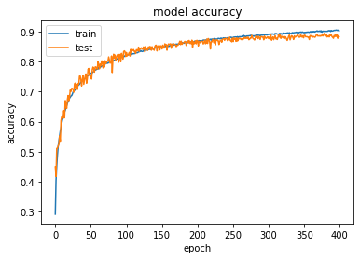
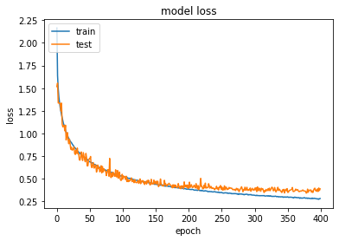
4. Training and results
Accuracy and loss of model over 400 epochs
Significant improvements from epoch 1-100

Slide 9
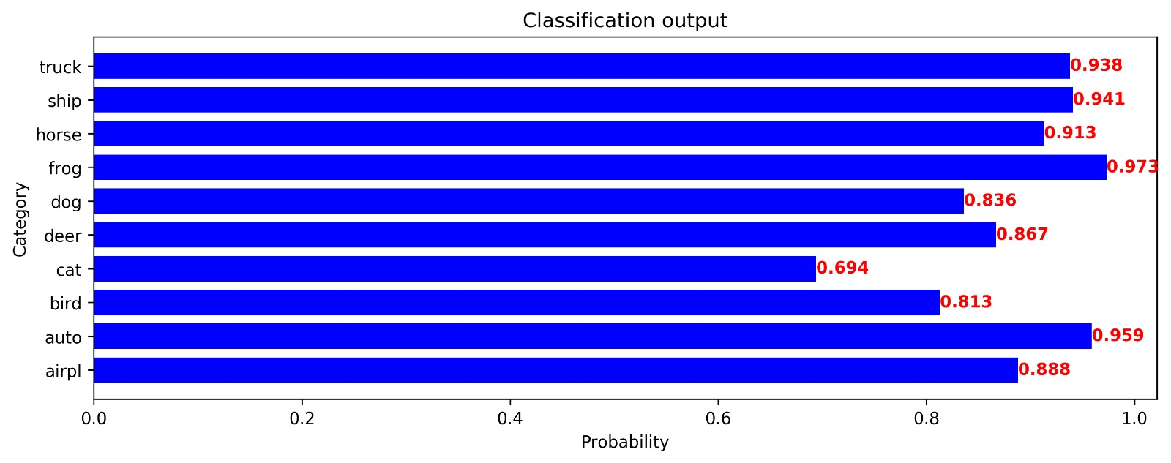
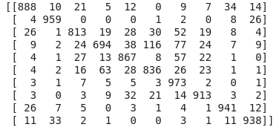
Results
4. Training and results
Confusion matrix and accuracy per class
Mis classified: cat as a dog
Highest accuracy: frog and automobile

Slide 10
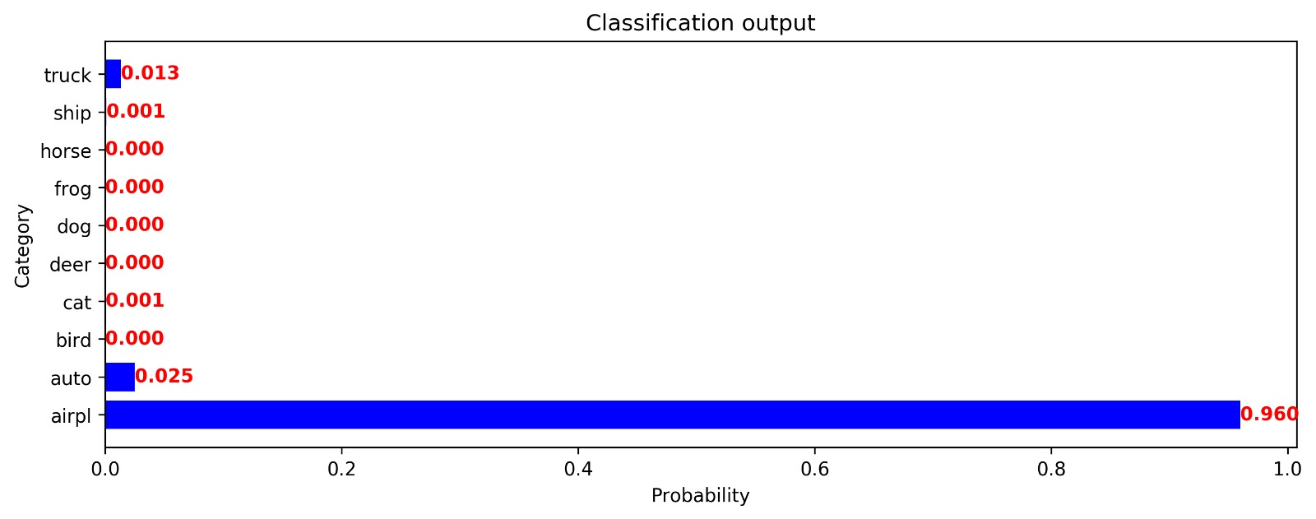

5. Test
After training the model, we present sample from different categories and these are the some of the results we have got:
Airplane example,
Probability = 0.94

Slide 11
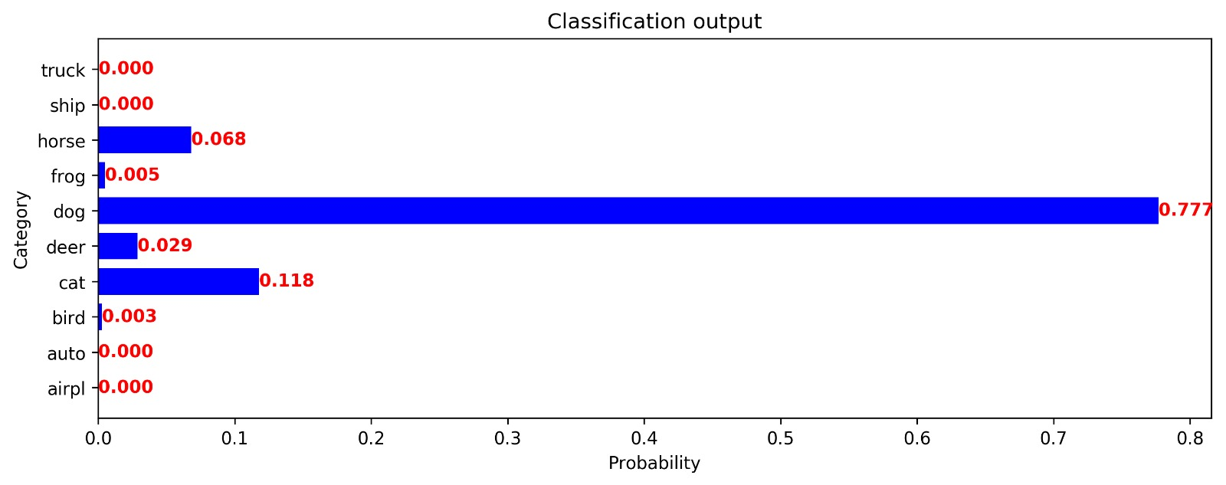
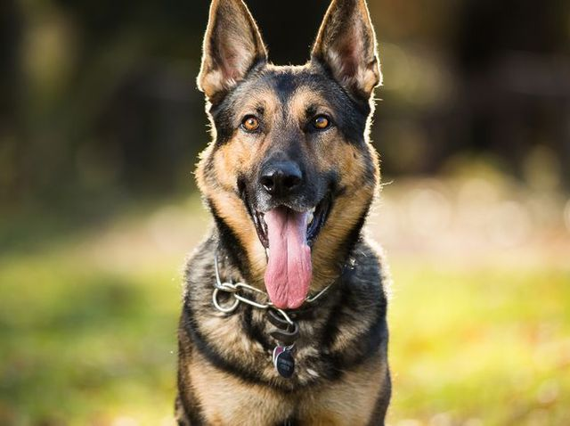
5. Test
Dog example,
Probability = 0.77

Slide 12
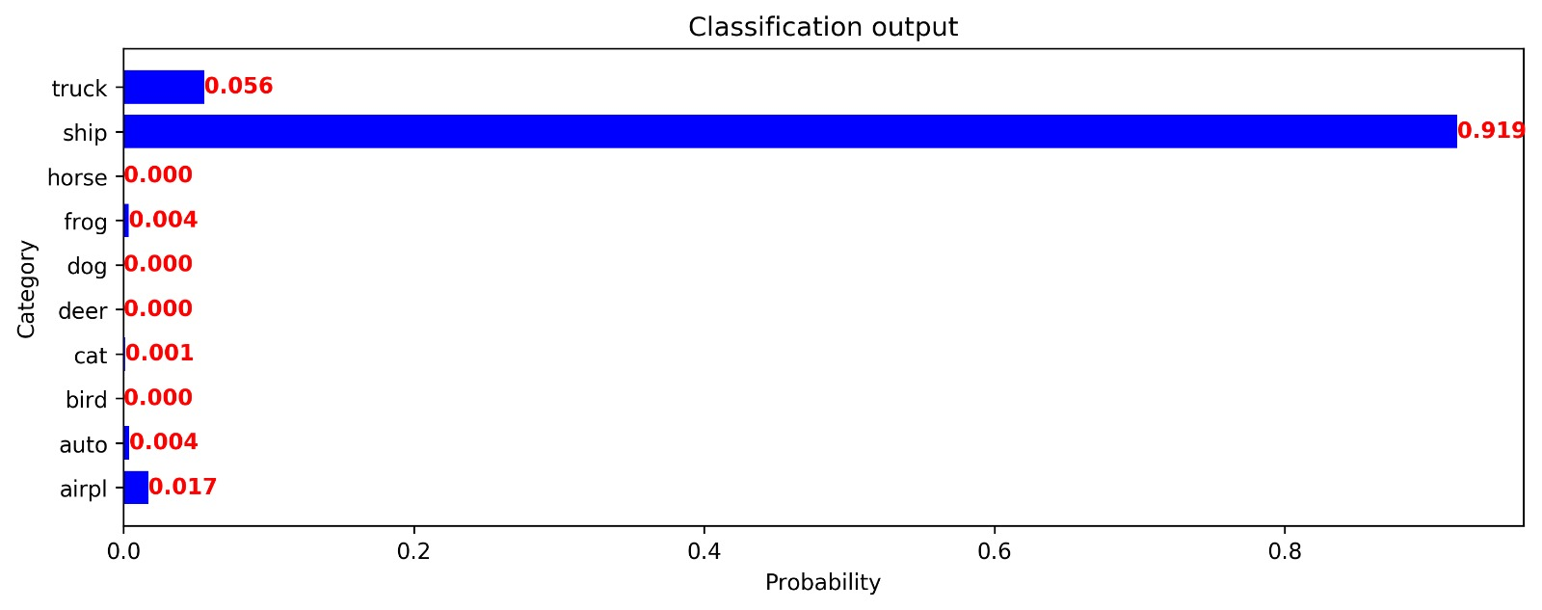
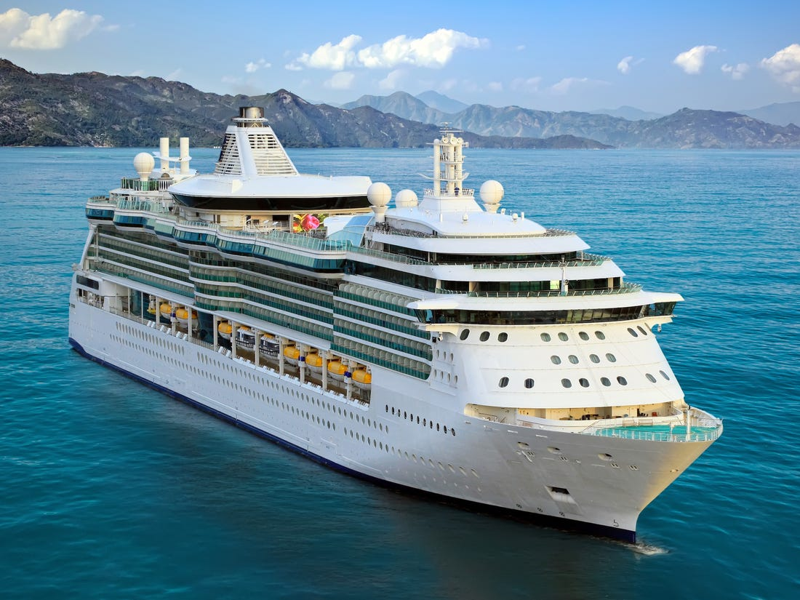
5. Test
Ship example,
Probability = 0.91

Slide 13
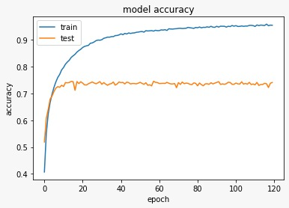
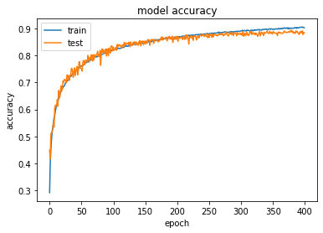
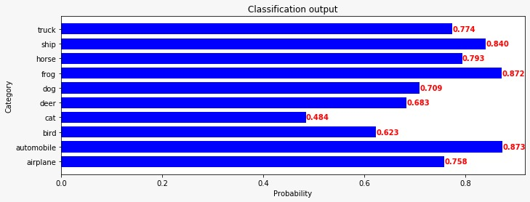
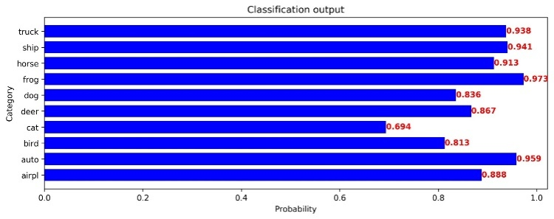
6. Comparison with the TSP
Notes:
The accuracy of TSP model reaches 74% after 10 epochs and then suffer over-fitting. In the other hand, with the Batch Normalization and Drop out Layer VGG-like model able to avoid over-fitting and have a higher accuracy in both accuracy per class and overall accuracy. In term of accuracy per class, both model have a low accuracy at cat images, and higher classification performance on frog and automobile images.

Slide 14
7. Conclusion
In conclusion, By using the presented architecture in model, we observed a serious impact on accuracy.
we’re able to improve the accuracy up to 14%.

